Slide 1
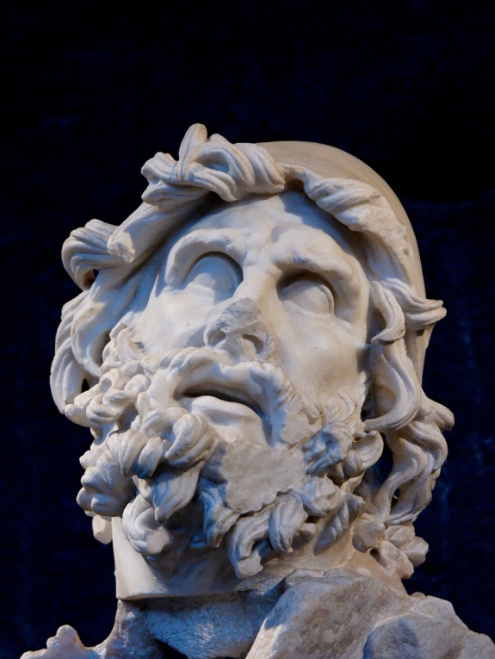
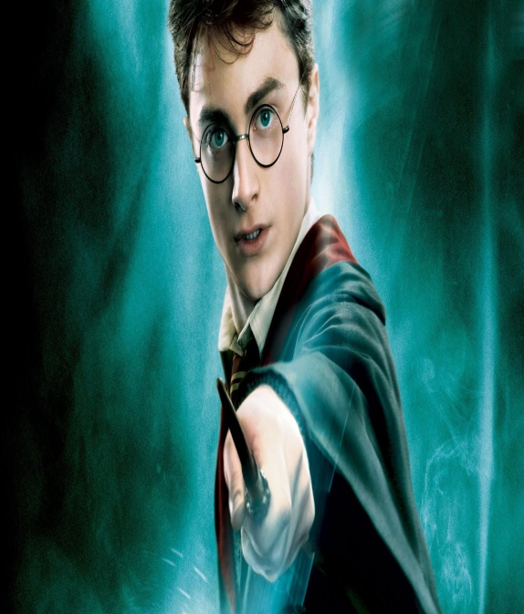
The Hero’s Journey

Slide 2
The Hero’s Journey
Also known as the monomyth.
The Hero’s Journey is a paradigm.
A paradigm is a model or standard form that governs our experience and sense of reality. The Hero Journey is both a physical as well as a psychological or emotional experience.
*Not all hero journeys will follow this paradigm exactly.

Slide 3
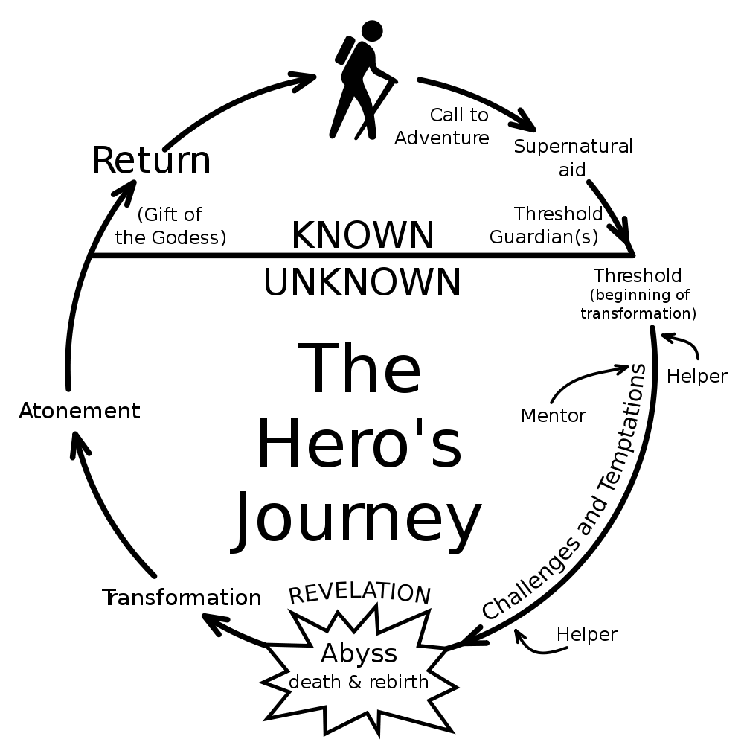

Slide 4
Stages of the Hero’s Journey
Stage 1:
The Ordinary World
This is the Hero’s home, the safe haven from which he must leave and seek to return to
Get to know and identify with the Hero’s drives, urges, and problems
Identify the problem (outer or inner) which disrupts the Ordinary World

Slide 5
Stages of the hero’s journey
Stage 2:
The Call to Adventure
Disrupts the comfort of the Hero’s Ordinary World
Often delivered by the Herald archetype
May come in different forms (a message, an action, an arrival, etc.)

Slide 6
Stages of the Hero’s Journey
Stage 3:
Refusal of the Call
The Hero has fears or insecurities
The Hero prefers the safe haven of the Ordinary World
The refusal demonstrates the risks involved in the Journey
Each call and refusal escalates the stakes until the Hero has no choice but to accept

Slide 7
Stages of the Hero’s Journey
Stage 4:
Meeting the Mentor
The Mentor provides confidence, insight, advice, training, or magical gifts
The Mentor may not be a person. It could be an object or an inner force such as a code

Slide 8
Stages of the Hero’s Journey
Stage 5:
Crossing the Threshold
Signifies that the Hero has finally committed to the journey
The threshold separates the Ordinary World from the Special World
*There is no turning back!!

Slide 9
Stages of the Hero’s Journey
Stage 6:
Tests, Allies, Enemies
The Hero learns the rules of the Special World
The Hero must learn who can be trusted
The Hero needs this stage to test his skills and powers

Slide 10
Stages of the Hero’s Journey
Stage 7:
Approach to the Abyss
The Abyss leads to the journey’s heart or central Ordeal
The Hero has survived his descent into the Special World
The Hero often takes a respite before facing the Ordeal

Slide 11
Stages of the Hero’s Journey
Stage 8:
The Ordeal/Revelation/Abyss
The central life-or-death crisis or crises
The Hero faces his greatest fear; experiences “death”
Only through “death” can the Hero be reborn
The resurrection grants greater powers or insight

Slide 12
Stages of the Hero’s Journey
Stage 9:
Reward
Having survived “death”, the Hero receives what he sought
It comes in many forms (a magical sword, an elixir, knowledge, reconciliation)
This allows the Hero to replenish himself and the audience to “catch its breath”

Slide 13
Stages of the Hero’s Journey
Stage 10:
The Road Back
The Hero must accept the Road Back to Ordinary World
Like crossing the threshold, the Hero needs an event that will push him back (a force to chase him out of the Special World)

Slide 14
Stages of the Hero’s Journey
Stage 11:
The Resurrection
The Hero’s most dangerous meeting with death
A cleansing or purification that must occur
The Hero is reborn or transformed
It may be a physical Ordeal with the entire world at stake
Must prove he has reached Heroic Status and accept his sacrifice for the benefit of the Ordinary World

Slide 15
Stages of the Hero’s Journey
Stage 12:
Return with the elixir
The final Reward
The Hero has been resurrected and purified and has earned the right to be accepted back into the Ordinary World
The Hero shares the Elixir of the journey with others or heals a wounded land
All celebrate the journey’s end with revelry or marriage
Harmony and balance are restored to the Ordinary World

Slide 16
The Archetypes
Archetypes describe the function or role the characters play in a story.
Think of an Archetype as a mask a character wears.
In a story, characters may change masks with other characters from time to time. The following slides list the Archetypes that occur most frequently along with their functions.

Slide 17
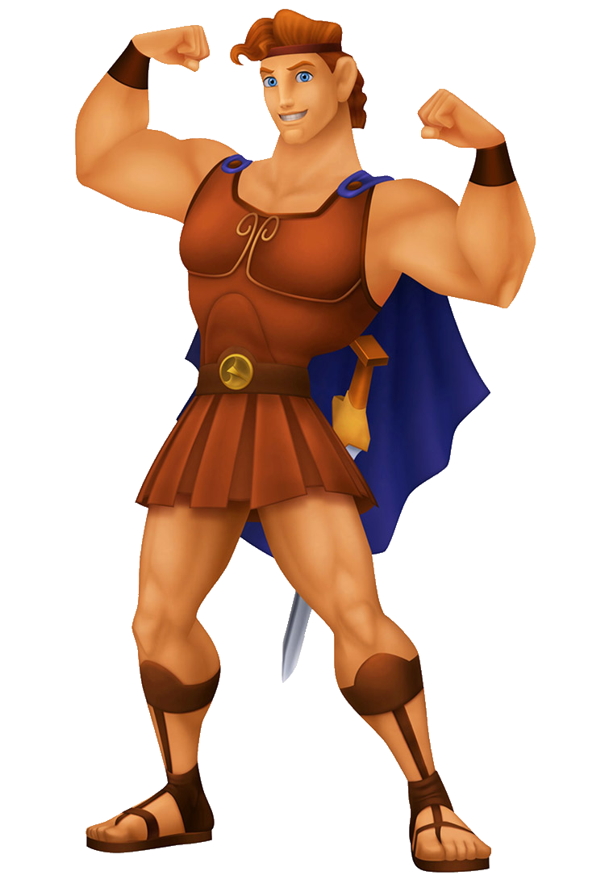
Archetype: The Hero
The Hero
(“to serve and sacrifice”)
His/her purpose is to separate and sacrifice self for the service of the Journey
He/she does not have to be all good (antiheroes, outlaws, loner heroes)
He/she grows or learns the most during the Journey

Slide 18
Archetype: The Mentor
The Mentor
(“to guide”)
The Mentor provides motivation, insight, training, guidance
Has traveled the road before
May provide the hero with magical gifts
May be an Inner Mentor like a code of honor or justice

Slide 19
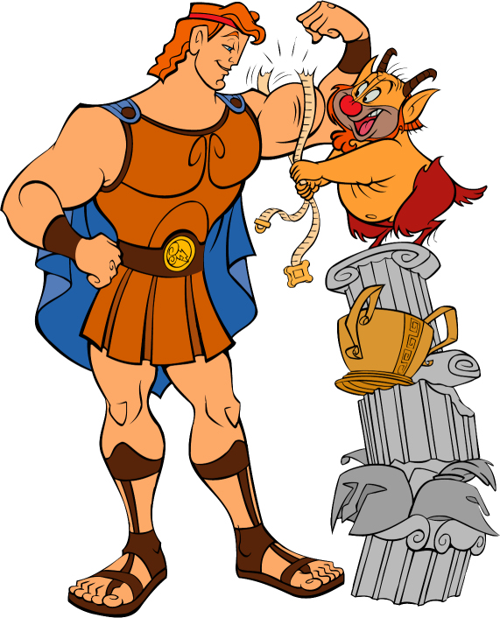
Archetype: Threshold Guardian
The Threshold Guardian (“to test”)
Protects the Special World and its secrets from the Hero
Provides Tests which the Hero must pass to prove commitment and worth
May be characters, objects, or forces

Slide 20
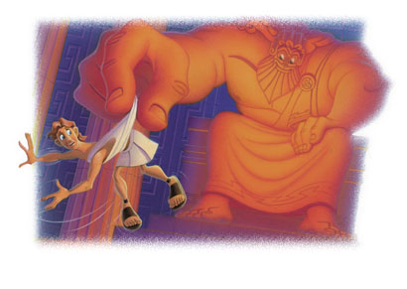
Archetype: The Herald
The Herald
(“to warn and challenge”)
Issues challenges or announces the coming of significant change
Often appears at the beginning of the Journey

Slide 21
Archetype: The Shapeshifter
The
Shapeshifter
(“to question and deceive”)
Misleads the Hero by hiding a character’s intentions and loyalties
Presence causes doubts and questions in the Hero’s mind
Creates suspense

Slide 22
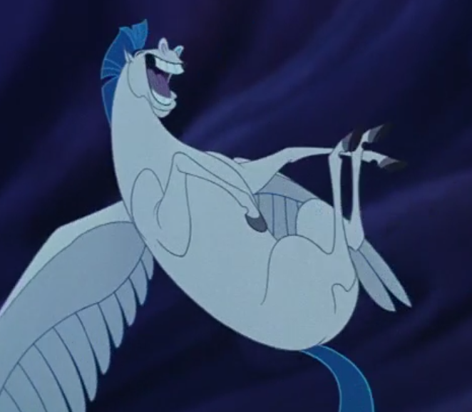
Archetype: the trickster
The Trickster
(“to disrupt”)
Disrupts the “status quo”, turning the Ordinary World into chaos
Uses laughter to help the Hero see the absurdity of a situation
Often is the Hero’s sidekick

Slide 23
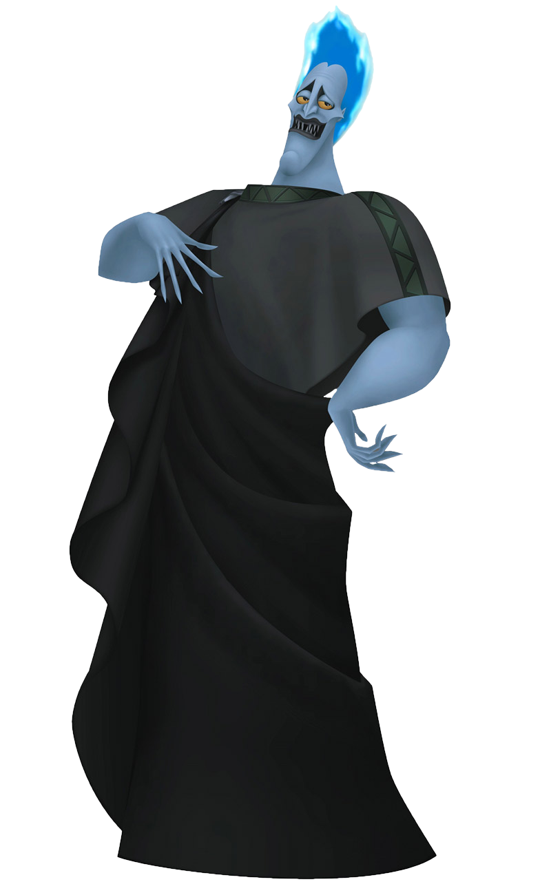
Archetype: The Shadow
The Shadow
(“to destroy”)
Represents our darkest or rejected desires
Symbolizes our greatest fears and phobias
May not be all bad
May be another character or something lurking within the Hero that must be accepted or purged

